Slide 1

NETFLIX
“Netflix completely shook up the world.”
Steven Van Zandt

Slide 2



The Team
Emmanuel Beltran
Zachary Smith
Abby Author, CTO
“Success is not final; failure is not fatal: it is the courage to continue that counts.” Winston Churchill
“Nothing in life worth having is doesn't come without sacrifice.
Duis aute irure dolor in reprehenderit in voluptate velit esse cillum dolore eu fugiat nulla pariatur

Slide 3
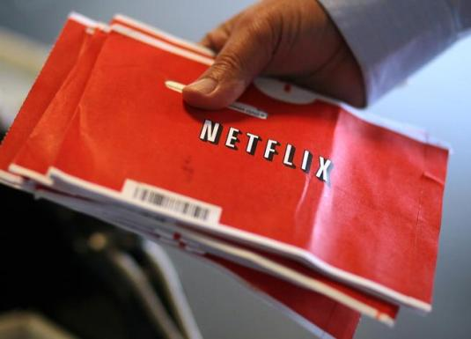
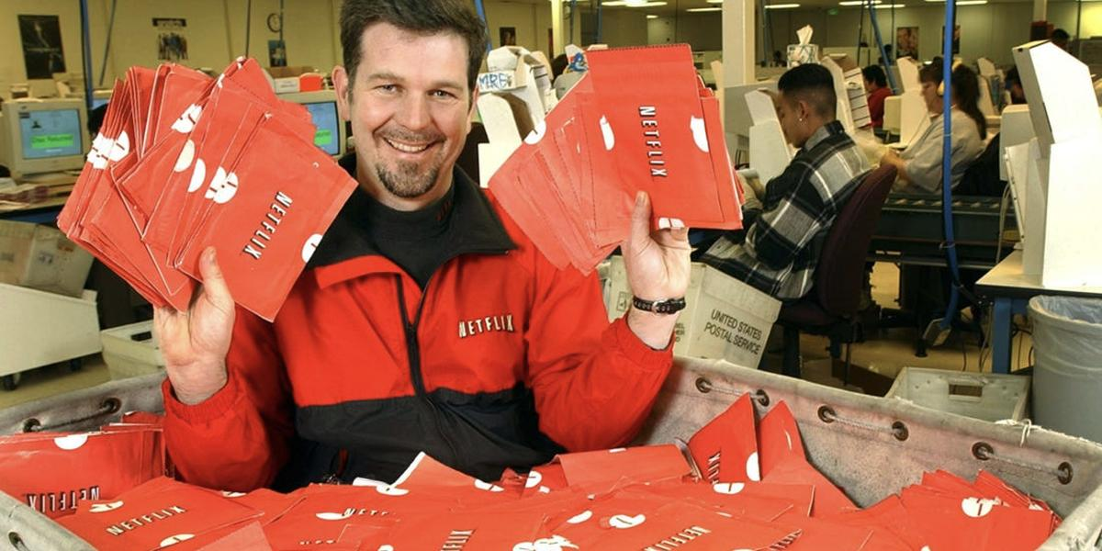
HISTORY & ACHIEVEMENTS
1998 2000 - launched the first DVD rental and sales site
2007 - introduced streaming
2018 - most Emmy nominated network
Now - Over 148 million in 190 countries
"The goal is to become HBO faster than HBO can become us." - Ted Sarantos

Slide 4
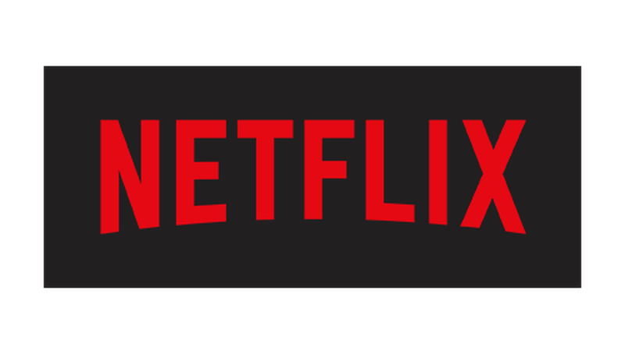
COMPETITIVE ADVANTAGE
PIONEERED IN TECH
TESTS IT’S ALGORITHM
INVESTS IN CONTENT
Flexibility
Unlimited content
No ads
Binge watching
Every year
Algorithm testing
Tests 300,000 users
Invests 6 billion annually
Average 125 original series and films annually
85% of spending on original content
“Don't be afraid to change the model.” - Reed Hastings

Slide 5
Environmental Factors
Political
Subject to regulation and government scrutiny.
Reasons
Governments have tightened their grip on the technology companies with regard to their data collection.
Economic
Netflix is a service and a leisure activity
Reasons
Higher economic activity and employment level lead to higher spending on leisure activities and entertainment

Slide 6
Environmental Factors
Socio Cultural
Netflix has customers from across the globe
Reasons
Since netflix has customers worldwide, it pays attentions to what people like to watch in different societies and cultures around the world
Shows you may see in the United states on Netflix you might not see on the Netflix in Mexico.
Technological
This is Netflix’s core factor.
Reasons
Netflix continues to improves its technology in order to continue to improve customer experience.
The company uses multiple technology in order to have certain shows or movies recommended to individuals.
Notes:
https://notesmatic.com/2020/04/pestel-analysis-of-netflix/

Slide 7
Environmental Factors
Environmental
Netflix is a online streaming service
Reasons
Since it is a online service, it does not have much direct environmental impact, but it does invest in the environment like every other major business.
Legal
Netflix is a digital industry/ technology
Reasons
Because of this, there are always new laws and legal actions as technology evolves.
One of the issues they deal with is customer privacy

Slide 8
Porters Five Force Analysis:
Competitive Rivalry
Has competetion with industries like Hulu, Redbox, Amazon etc.
In 2008, Netflix spent $200 million dollars in advertisment
Supplier Power
Though netflix has some shows its made, its mostly dependent on getting its content from Studios (Disney, Pixar, Universal, etc..)
If suppliers stop sharing content, this could cripple netflix, which gives suppliers major power over contract negotiations.
Notes:
https://www.researchgate.net/profile/Zana_Sadq/publication/318727246_Analysising_Netflix_s_Strategy/links/597a60ccaca272e8cc12daa8/Analysising-Netflix-s-Strategy.pdf

Slide 9
Porters Five Force Analysis:
Buyer Power
Customers have high power when it comes to deciding prices for Netflix. This is because during times when the economy is slow, customers may choose to spend their entertainment money on cheaper services and products.
With increase in other streaming services, buys have more power to also go and buy from other services like Disney plus or Hulu, which makes Netflix lose customers.
Substitution
Digital cable is seen in most homes, with services like Hulu, Amazon Prime, etc.. Netflix has to keep up continuous changing technology so they can have the advantage over these substitutions.
Notes:
https://www.researchgate.net/profile/Zana_Sadq/publication/318727246_Analysising_Netflix_s_Strategy/links/597a60ccaca272e8cc12daa8/Analysising-Netflix-s-Strategy.pdf

Slide 10
Porters Five Force Analysis:
New Entry Competition
Netflix has to keep enhancing and improving its inventory of streamed movies/ shows
If they were to stop enhancing their inventory, this will allow companies to open and gain the movies/shows that they can not stealing customers.
Notes:
https://www.researchgate.net/profile/Zana_Sadq/publication/318727246_Analysising_Netflix_s_Strategy/links/597a60ccaca272e8cc12daa8/Analysising-Netflix-s-Strategy.pdf

Slide 11
Internal Analysis:
Strengths:
-Brand equity
-Large platform of content producers -Original content creation
Weaknesses:
-Limited business model
-Dependence on other content producers
-
Strengths and Weaknesses
Notes:
https://www.rancord.org/netflix-swot-analysis-internal-external-strategic-factors

Slide 12
Busniess Level Strategy
Netflix’s competitive strategy is cost-leadership based on subscription-based business model
Ensures competitive advantage through minimized costs and selling prices
Sustainability of this strategy involves three plans; basic, standard and premiums
Cost-Leadership
Notes:
https://notesmatic.com/2020/04/generic-and-intensive-strategies-of-netflix/

Slide 13
Conclusion
In conclusion, Netflix has faced many challenges but still persisted in performance
This has been attributed to its cost-leadership business strategy, which is based on subscription-based model
This industry analysis has shown that Netflix has potential to grow if it continues to focus on three competitive advantage positions

